Slide 1
RANDOM SCAN DISPLAYS AND RASTER SCAN DISPLAYS

Slide 2
RASTER SCAN DISPLAY
Raster: A rectangular array of points or dot.
An image is subdivided into a sequence of (usually horizontal) strips known as "scan lines“ which can be further divided into discrete pixels for processing in a computer system.
A raster image is a collection of dots called pixels

Slide 3

RASTER IMAGE

Slide 4
WORKING
In a raster scan system, the electron beam is swept across the screen, one row at a time from top to bottom.
As the electron beam moves across each row, the beam intensity is turned on and off to create a pattern of illuminated spots.
The return to the left of the screen, after refreshing each scan line is called Horizontal retrace.
At the end of each frame the electron beam returns to the top left corner of the screen to begin the next frame is called Vertical retrace:

Slide 5
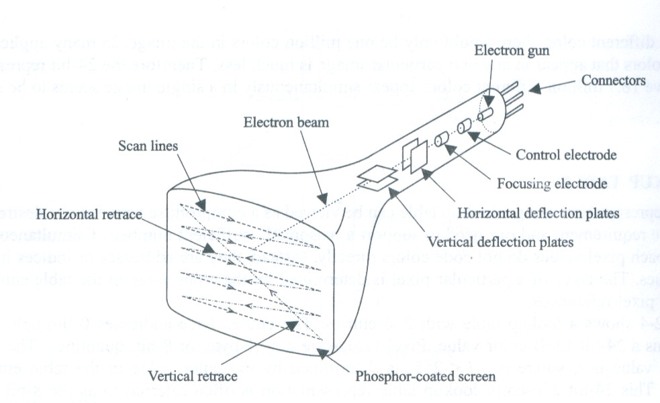
Raster Scan Display

Slide 6
WORKING
Picture definition is stored in a memory area called the refresh buffer or frame buffer.
Refresh buffer or frame buffer is memory area that holds the set of intensity values for all the screen points.
Stored intensity values then retrieved from refresh buffer and “painted” on the screen one row (scan line) at a time.

Slide 7
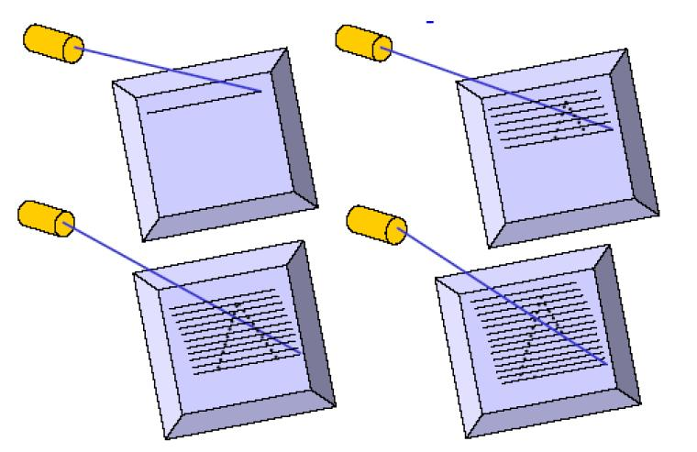
Object as set of discrete points across each scan line

Slide 8
The quality of a raster image is determined by the total number pixels (resolution), and the amount of information in each pixel (color depth)
A black-and-white system: each screen point is either on or off, so only one bit per pixel is needed to control the intensity of screen positions. Such type of frame buffer is called Bit map
High quality raster graphics system have 24 bits per pixel in the frame buffer (a full color system or a true color system)
Refreshing on raster scan displays is carried out at the rate 60 to 80 frame per second.

Slide 9
INTERLACING
On some raster systems (TV), each frame is displays in two passes using an interlaced refresh procedure.
Interlacing is primarily used for slower refresh rates.
An effective technique to avoid Flicker.(Flicker occurs on CRTs when they are driven at a low refresh rate, allowing the brightness to drop for time intervals sufficiently long to be noticed by a human eye)
Notes:
Flicker occurs on CRTs when they are driven at a low refresh rate, allowing the brightness to drop for time intervals sufficiently long to be noticed by a human eye

Slide 10
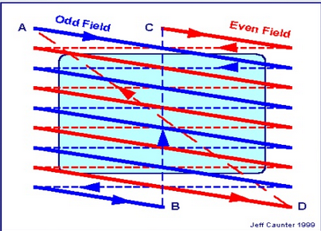
INTERLACING

Slide 11
APPLICATIONS
Suited for realistic display of screens
Home television computer printers create their images basically by raster scanning. Laser printers use a spinning polygonal mirror (or an optical equivalent) to scan across the photosensitive drum, and paper movement provides the other scan axis
Common raster image formats include BMP (Windows Bitmap), JPEG (Joint Photographics Expert Group), GIF (Graphics Interchange Format) , PNG (Portable Network Graphic), PSD (Adobe PhotoShop)

Slide 12
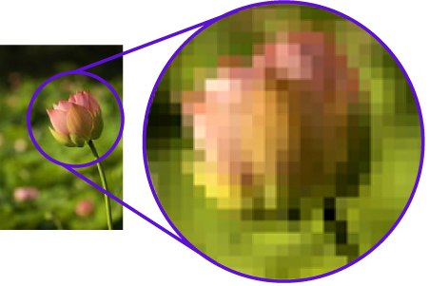
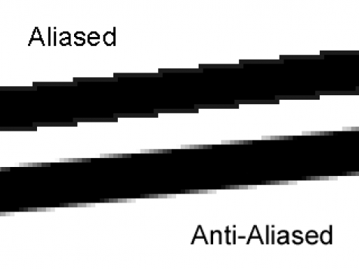
DISADVANTAGE
To increase size of a raster image the pixels defining the image are be increased in either number or size Spreading the pixels over a larger area causes the image to lose detail and clarity.
Produces jagged lines that are plotted as discrete points

Slide 13
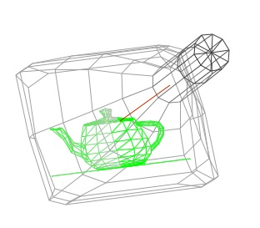
RANDOM SCAN DISPLAY
Random scan display is the use of geometrical primitives such as points, lines, curves, and polygons, which are all based upon mathematical equation

Slide 14
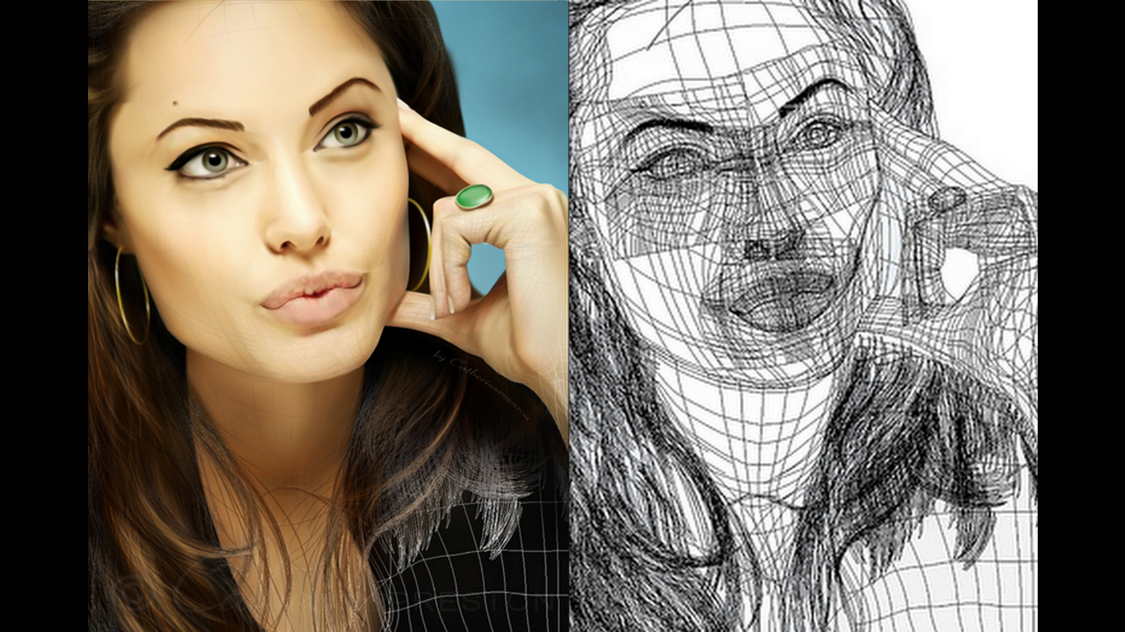
VECTOR IMAGE

Slide 15
WORKING
When operated as a random-scan display unit, a CRT has the electron beam directed only to the parts of the screen where a picture is to be drawn.
Random-scan monitors draw a picture one line at a time and for this reason are also referred to as vector displays (or stroke-writing or calligraphic displays).

Slide 16
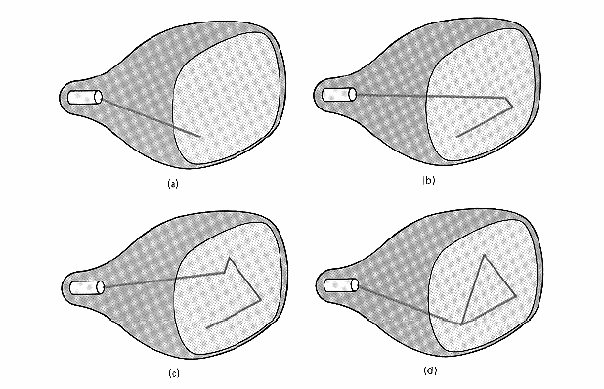
RASTER SCAN DISPLAY

Slide 17
Refresh rate depends on the number of lines to be displayed.
Picture definition is now stored as a line-drawing commands an area of memory referred to as refresh display file (display list).
To display a picture, the system cycle through the set of commands in the display file, drawing each component line in turn.
Random scan displays are designed to draw all the component lines of a picture 30 to 60 times each second

Slide 18
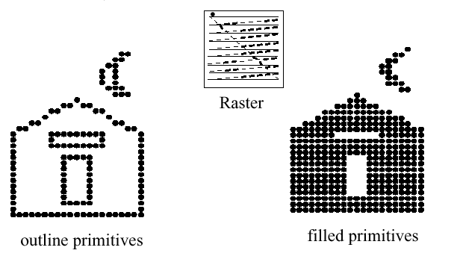
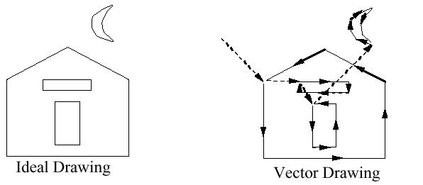
A Raster system produces jagged lines that are plotted as discrete points sets.
Raster
Outline primitives
Filled primitives
Vector displays product smooth line drawing
Ideal Drawing
Vector Drawing

Slide 19


Random scan displays are designed for line-drawing applications and can not display realistic shaded scenes

Slide 20
Advantages
Random scan displays have higher resolution than raster systems.
Vector displays product smooth line drawing.
This minimal amount of information translates to a much smaller file size. (file size compared to large raster images)
On zooming in, and it remains smooth
The parameters of obje.cts are stored and can be later modified.

Slide 21
RASTER SCAN SYSTEM
In addition to the central processing unit (CPU), a special processor, called the video controller or display controller, is used to control the operation of the display device.
A fixed area of the system memory is reserved for the frame buffer, and the video controller is given direct access to the frame buffer memory.
Operation performed:
Refreshing operation
Transformation (Areas of the screen can be enlarged, reduces, or moved during the refresh cycles)

Slide 22
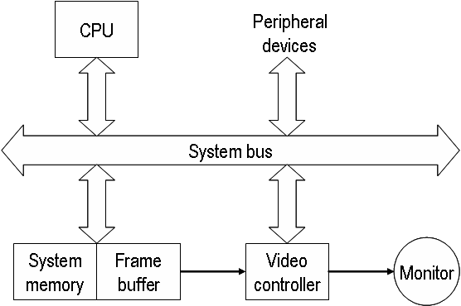

Slide 23
The Basic refresh operation of the video controller.
Frame buffer location, and the corresponding screen positions, are referenced in Cartesian coordinates
Scan lines are then labeled from y_{max} at the top of the screen to 0 at the bottom. Along each scan line, screen pixel positions are labeled from 0 to x_{max}
Two registers are used to store the coordinates of the screen pixels.
y
y max
Line Scan
x
x max

Slide 24
Raster Scan Generator
x Register
y Register
Memory Address
Frame Buffer
Intensity

Slide 25
DISPLAY PROCESSOR
The purpose of the DP is to free the CPU from the graphics chores.
A major task of the display processor is Scan Conversion.
Scan Conversion: is digitizing a picture definition given in an application program into a set of pixel intensity values for storage in the frame buffer.

Slide 26
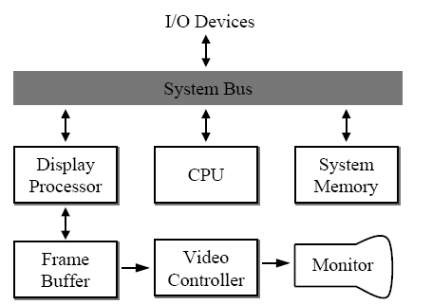
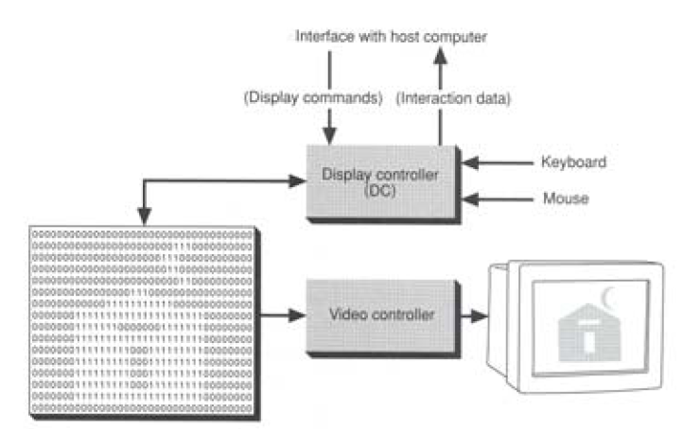

Slide 27
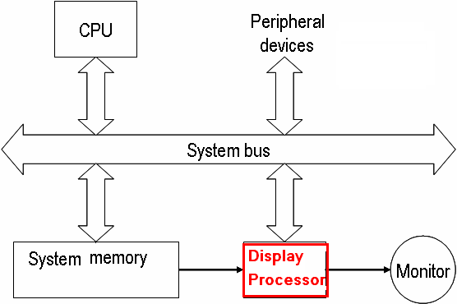
RASTER SCAN SYSTEM
Graphic commands are translated by the graphics package into a display file stored in the system memory.
This file is then accessed by the display processor unit (DPU)(graphic controller) to refresh the screen.

Slide 28
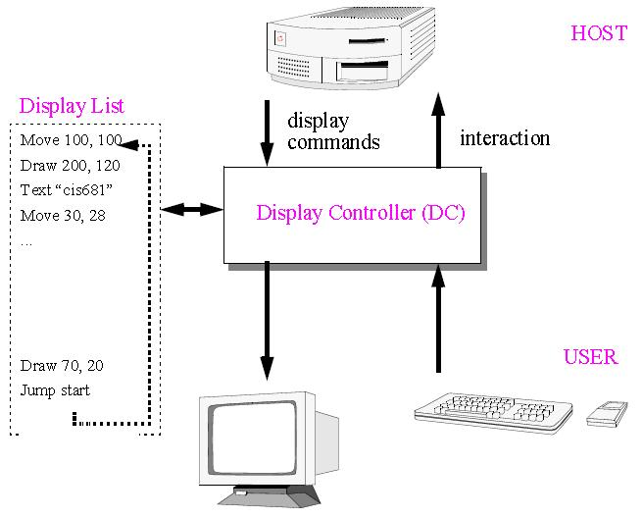
RASTER SCAN SYSTEM

